Slide 1
Agile Principles and Practices
Agile Development Processes
Eric Knauss

Slide 2
Announcements
Challenge lab
Optional workshop on Git / Github / Android on Thursday, 2016-04-21?
Please indicate interest (now, email, or via course representatives)
Any Roadblocks?

Slide 3
Overview
What is Software Engineering?
Repetition: Principles and Practices
XP
Scrum
Kanban (you did watch the video, right?)
(Lean software development)

Slide 4
What is Software Engineering?
Some philosophy

Slide 5
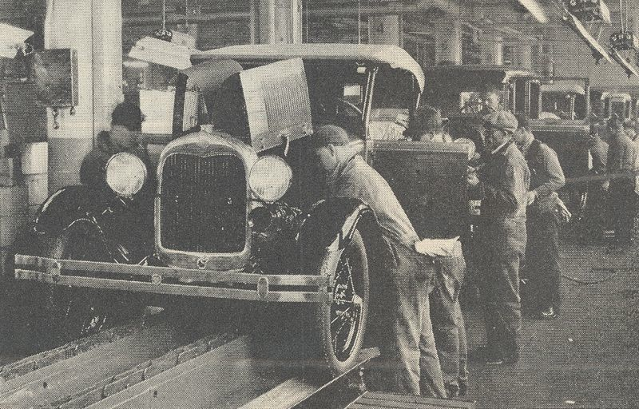
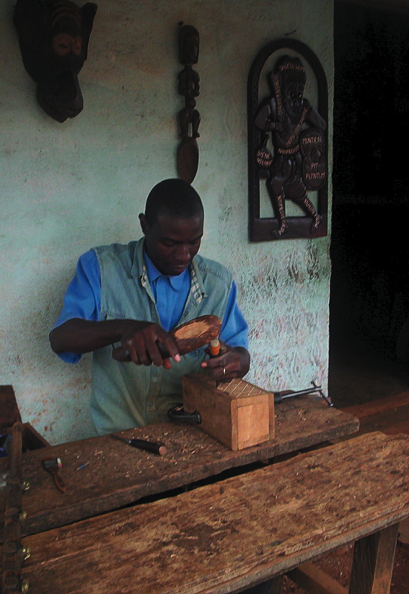
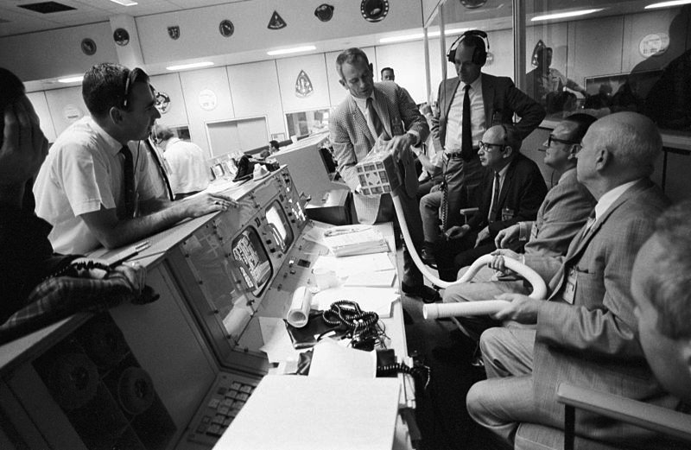
Some comparisons
Production?
Engineering?
Design?
Craft?
Art?
Theory building?
Collaborative game of invention and communication?
Rock-Climbing
Swamp-Game
http://commons.wikimedia.org/wiki/File:Bamun_artisan.jpg
http://en.wikipedia.org/wiki/Fordism
http://en.wikipedia.org/wiki/Aerospace_engineering
Notes:
About the pictures:
Engineering: NASA engineers, seen here in mission control during Apollo 13, worked diligently to protect the lives of the astronauts on the mission.
Production: Ford cars (Model A shown), became a symbol of effective mass production. Efficiency both decreased the price of the cars and allowed Henry Ford to increase the workers' wages. Hence, common workers could buy their own cars. http://en.wikipedia.org/wiki/Fordism

Slide 6
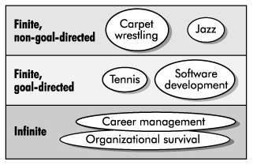
Software Development as a Game
Zero-sum game?
SW-Dev: No, more than one winner
Positional game?
SW-Dev: Some play it like this (comprehensive documentation shows current state of game)
Competitive / Cooperative game?
SW-Dev: Cooperative!!!
Goal directed?
SW-Dev: Definitely
Finite/ infinite?
Cockburn: Agile software development, the cooperative game, 2nd edition

Slide 7
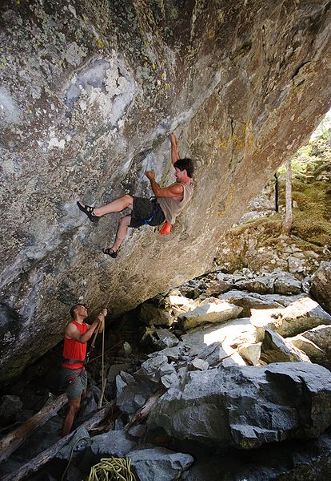
Rock-climbing vs Software Development
Cooperative and goal seeking
Load bearing (limited amount of possible moves)
Team
Individuals with talent (some are simply better)
Skill-sensitive (practice helps to improve)
Training (you need to hone your skllls)
Tools (get more critical the more ambitious the project is)
Resource-limited
Plan
Improvised
Fun
Challenging
Dangerous
http://commons.wikimedia.org/wiki/File:Overhanging_rock_climbing_1.jpg
Cockburn: Agile software development, the cooperative game, 2nd edition

Slide 8
Software Development as Manufacturing
 | Manufacturing Mass Production | Waterfall Model
Hidden Cost | Transportation Managing inventory and storage Capital costs of inventory | Handoffs Lots of open items; can lead to overwhelming the workforce Cost of training people to build software
Risks | Building things you don’t need because production goes on after needs go away Inventory becoming obsolete Huge latency if an error occurs | Building things you don’t need because requirements aren’t clear or customers change their minds Knowledge degrading quickly If a line is discontinued, all WIP wasted Errors in requirements discovered late in the process Errors in completed code discovered late in testing
Lean-Agile Software Development: Achieving Enterprise Agility, by Alan Shalloway, Guy Beaver, and Jim Trott. Chapter 1.

Slide 9
Repetition
Agile Principles and Practices

Slide 10
Agile Principles
Early and continuous delivery of valuable software
Welcome changing requirements, even late
Deliver working software frequently
Business people and developers must work together
Build projects around motivated individuals
Face-to-face communication is most effective and efficient
Working software is the primary measure of progress
Sustainable development
Continuous attention to technical excellence and good design
Simplicity is essential
Self-organizing teams
Regular reflection
Notes:
Take two minutes to discuss with your neighbour: Which are easy, which are hard to follow in your project?

Slide 11
XP Principles
Core
Less central
Rapid feedback
Assume simplicity
Incremental change
Embracing change
Quality work
Teach learning
Small initial investment
Play to win
Concrete requirements
Open, honest communication
Work with people’s instincts, not against them
Accepted responsibility
Local adaptation
Travel light
Hones measurement

Slide 12
XP Practices
Planning game
Small releases
Metaphor
Simple design
Testing
Refactoring
Pair programming
Collective ownership
Continuous integration
40h week
On-site customer
Coding standards

Slide 13
Scrum Principles
Reflection
Stop and review product & process
Self-correction
Based on reflection
Visibility
Everything is visible (=known) for all stakeholders, e.g. plans, schedules, issues, …

Slide 14
Scrum practices
Product backlog vs. Sprint backlog
Sprint planning
Planning poker: estimate cost
ROI (Return on Investment): cost vs. benefit
Retrospective
Fixed sprint length
Burn-down charts
Daily scrum: no longer than 15min

Slide 15
Kanban principles
Start with what you do now
Agree to pursue incremental, evolutionary change
Respect the current process, roles, responsibilities and titles
Leadership at all levels
The following is based on [KS2009]

Slide 16
Kanban core practices
Visualize
Visualization of workflow allows to understand and improve it
Limit Work-in-Progress
Limit the amount of workitems for each step
Introduce a pull-system
Manage flow
Measure how workitems flow through the process and understand, if a change improves the situation
Make policies explicit
Implement feedback loops
Understand (as a team) how good the process is working
Improve collaboratively, evolve experimentally
Whole team needs to share a theory on why (small) change helps

Slide 17
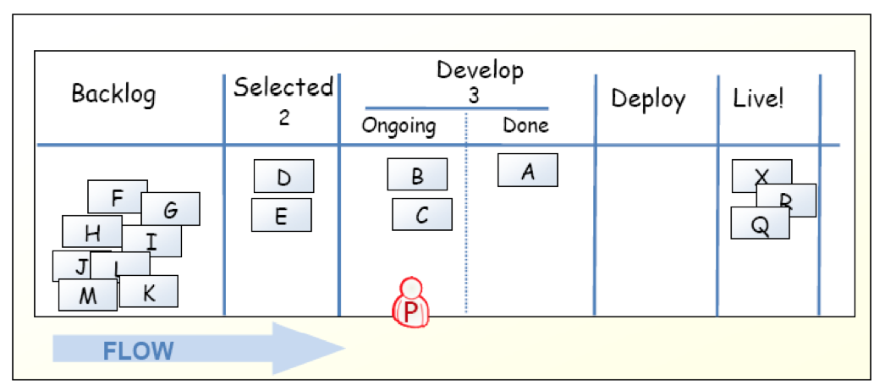
Kanban-Board
[KS2009]

Slide 18
Limit work in progress
Prevent context switching
Reduce multi-tasking
performing tasks sequentially yields results sooner
Maximize throughput
Enhance teamwork
working together to make things done
increase cross-functionality

Slide 19
WIP Strategy
Start with some initial value
Small constant (1-3)
number of developers
number of testers
Measure the cycle time
average time of one piece full cycle flow
Change limit to decrease cycle time

Slide 20
Idle Members
Can you help progress an existing kanban? – Work on that.
Don’t have the right skills? – Find the bottleneck and work to release it.
Don’t have the right skills? – Pull in work from the queue.
Can’t start anything in the queue? – Check if there is any lower priority to start investigating.
There is nothing lower priority? – Find other interesting work (refactoring, tool automation, innovation).

Slide 21
Metrics
Stories in progress (SIP)
When story enters stories queue set entry date (ED)
When story enters first process step set start processing date (SPD)
When story is done set finish date (FD)
Cycle time (CT) = FD – SPD
Waiting time (WT) = SPD – ED
Throughput (T) = SIP / CT

Slide 22
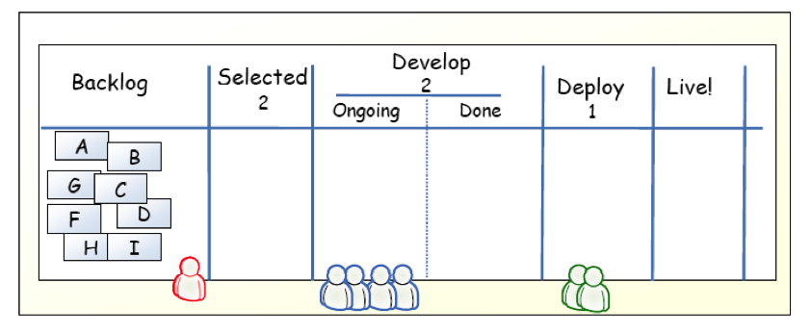
Example
[KS2009]

Slide 23
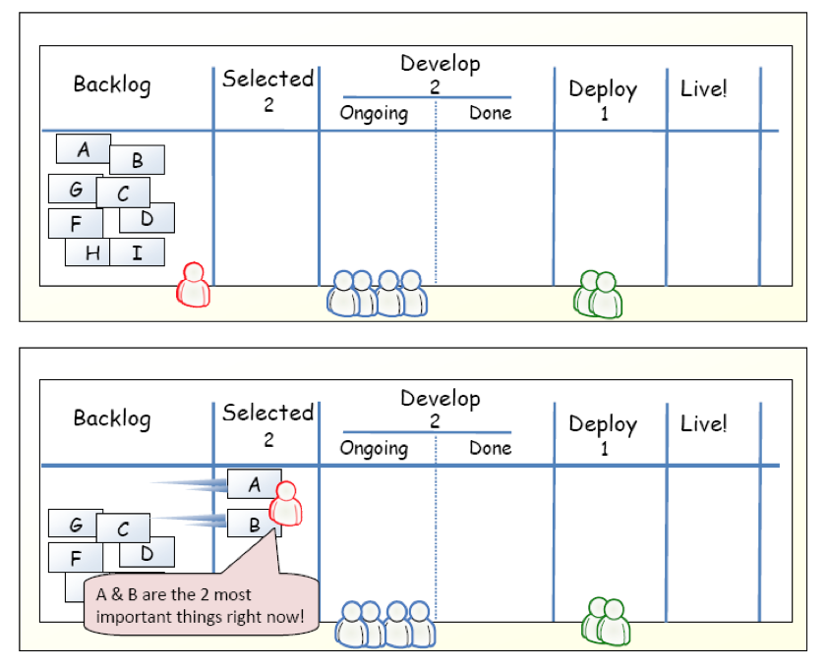
Example
[KS2009]

Slide 24
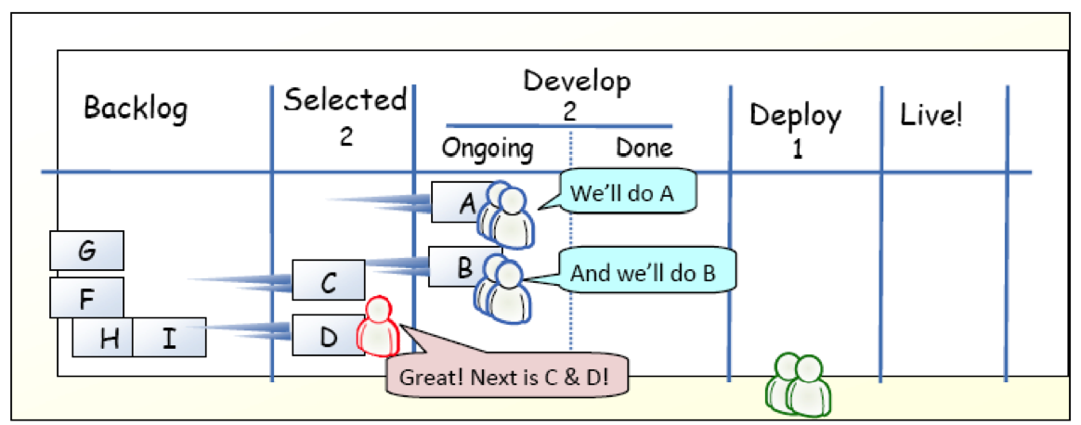
Example
[KS2009]

Slide 25
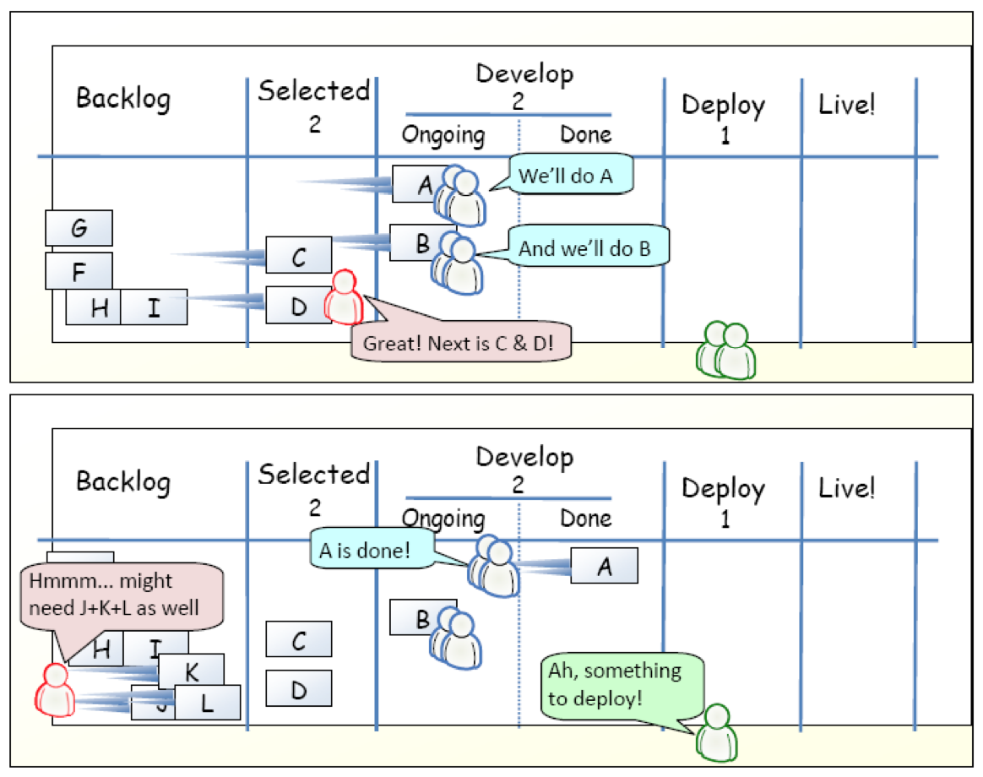
Example
[KS2009]

Slide 26
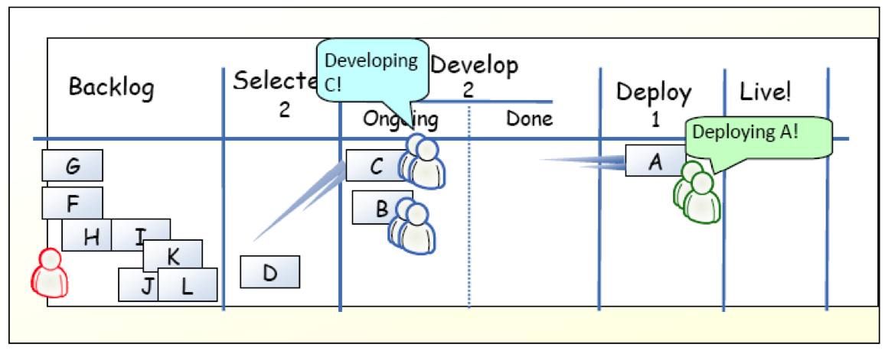
Example
[KS2009]

Slide 27
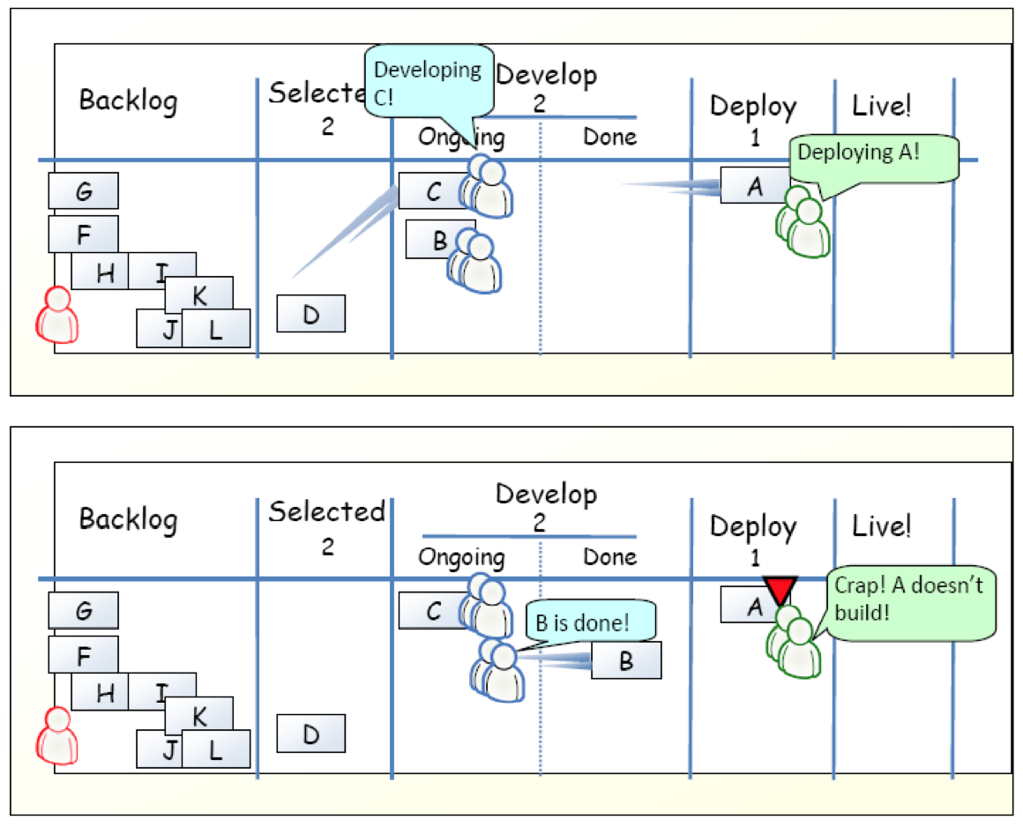
Example
[KS2009]

Slide 28
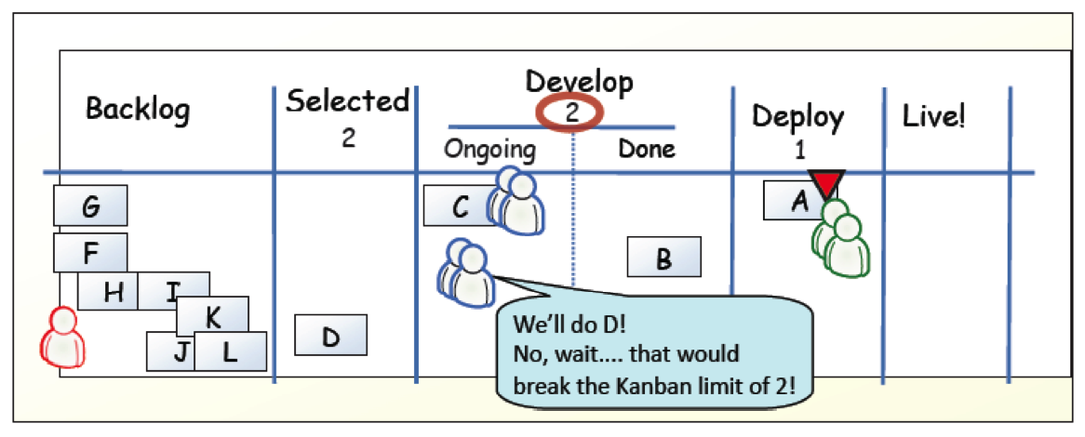
Example
[KS2009]

Slide 29
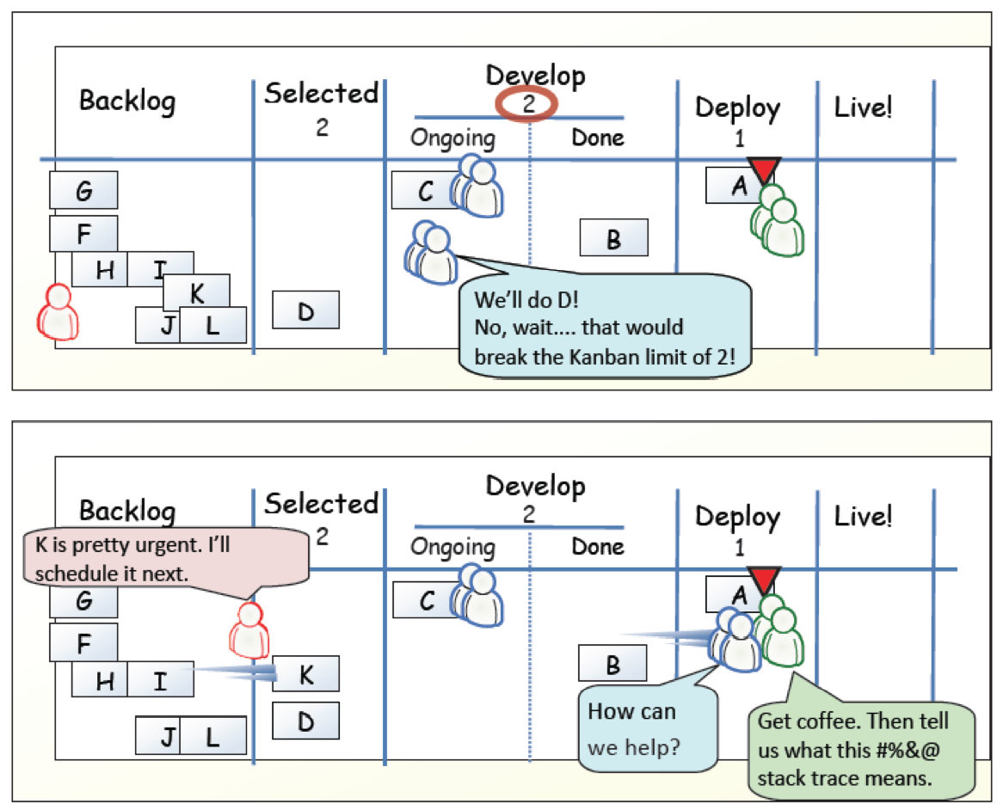
Example
[KS2009]

Slide 30
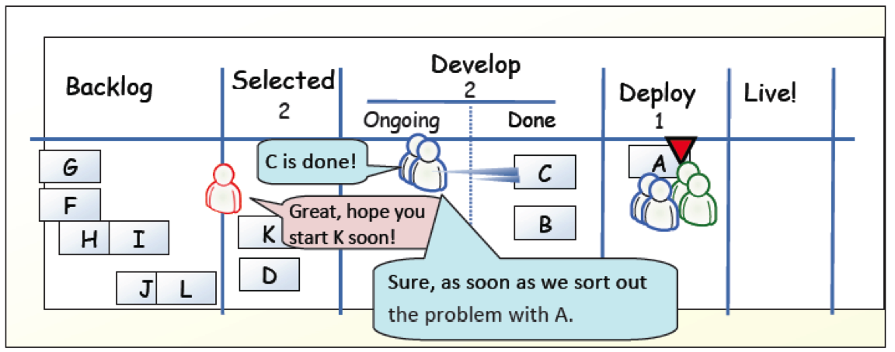
Example
[KS2009]

Slide 31
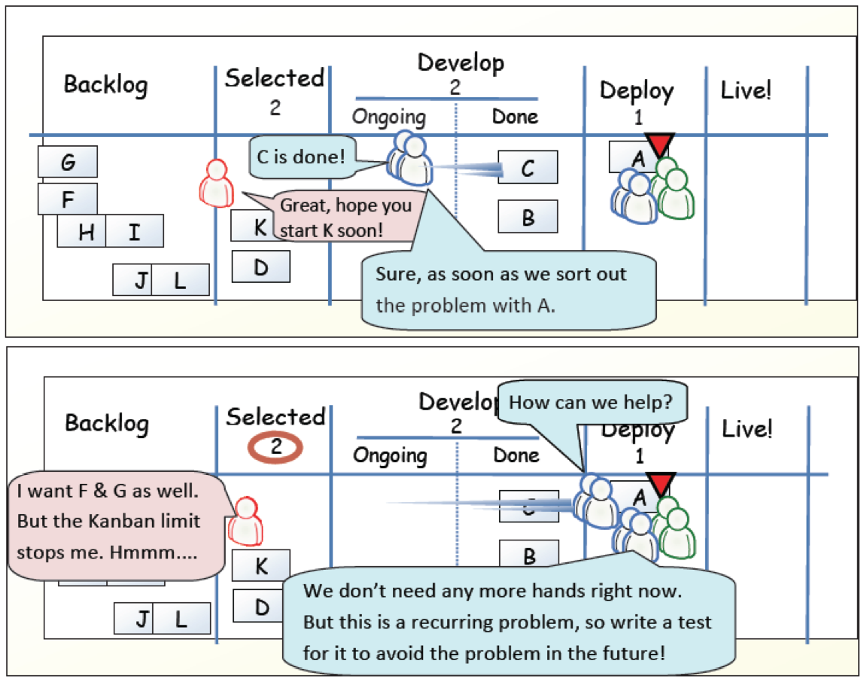
Example
[KS2009]

Slide 32
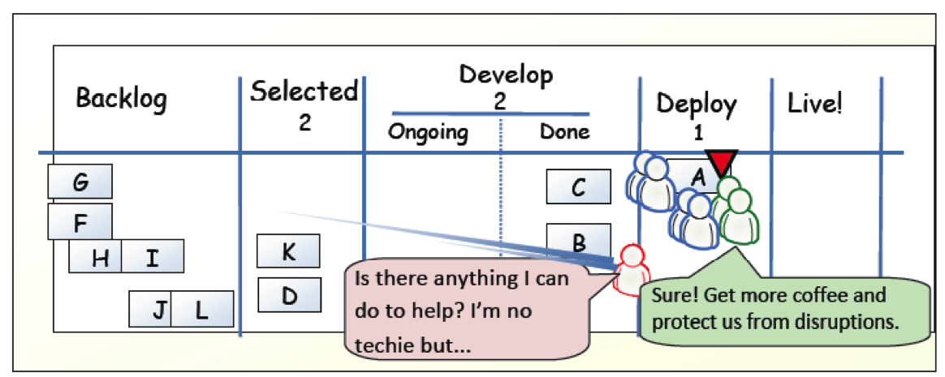
Example
[KS2009]

Slide 33
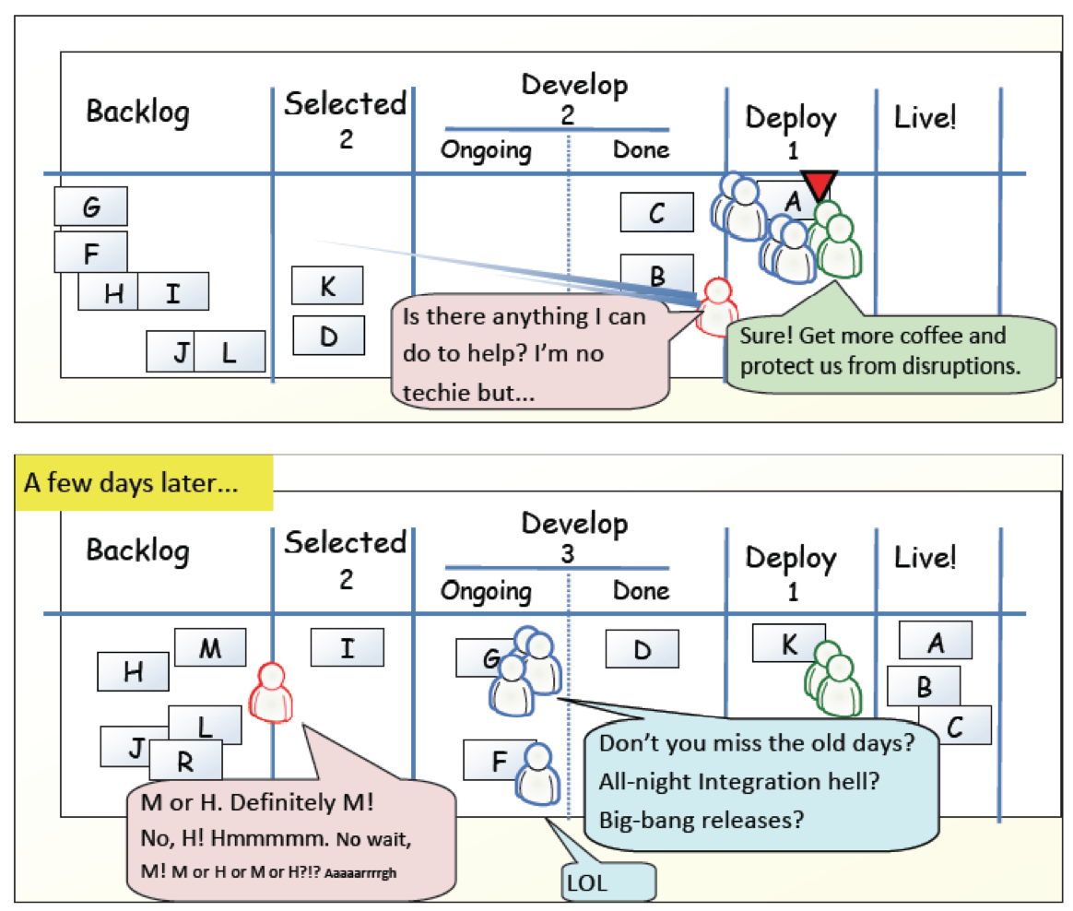
Example
[KS2009]

Slide 34
?
Compare Kanban with your favorite agile method.
What is similar?
What is different?
Is Kanban agile?

Slide 35
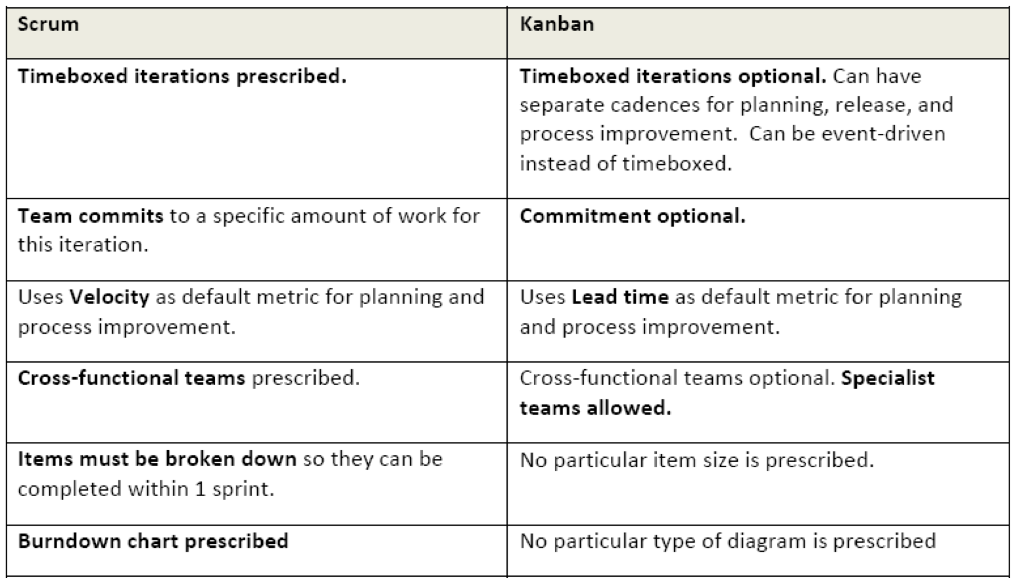
Scrum vs. Kanban
[KS2009]

Slide 36
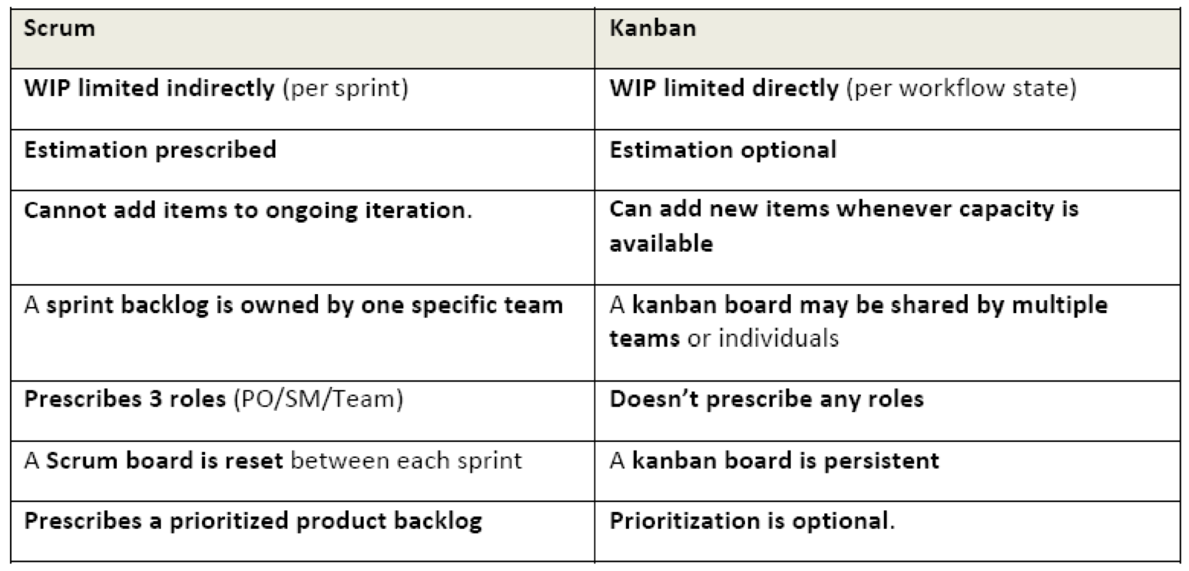
Scrum vs. Kanban
[KS2009]

Slide 37
Agile Principles
Early and continuous delivery of valuable software
Welcome changing requirements, even late
Deliver working software frequently
Business people and developers must work together
Build projects around motivated individuals
Face-to-face communication is most effective and efficient
Working software is the primary measure of progress
Sustainable development
Continuous attention to technical excellence and good design
Simplicity is essential
Self-organizing teams
Regular reflection
Task: For each of the principles, compare XP, Scrum, and Kanban and discuss differences
NOW: Pick two – the others might be a good exercise for exam and report.
Notes:
Task: For each of the principles, compare XP, Scrum, and Kanban and discuss differences
NOW: Pick two – the others might be a good exercise for exam and report.

Slide 38
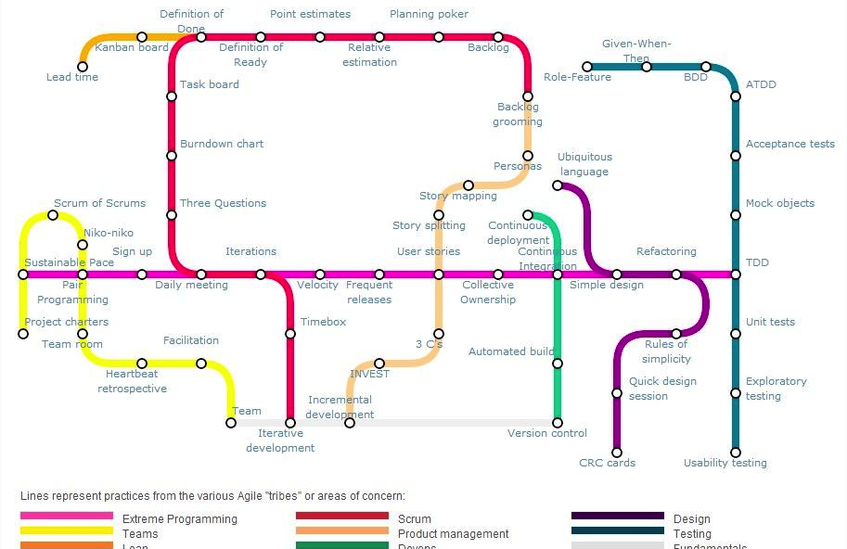
Agile Practice Map
https://techblog.betclicgroup.com/wp-content/uploads/2013/12/agileSubwayMap2.jpg
Also check: http://guide.agilealliance.org
Notes:
Also check http://guide.agilealliance.org

Slide 39
References
[KS2009] Henrik Kniberg and Mattias Skarin: Kanban and Scrum – Making the Most of Both. InfoQ (2009) Available online:http://infoq.com/minibooks/kanban-scrum-minibook

Slide 40
Post-Lecture Additions
Placeholder for Scrum practices

